Slide 1
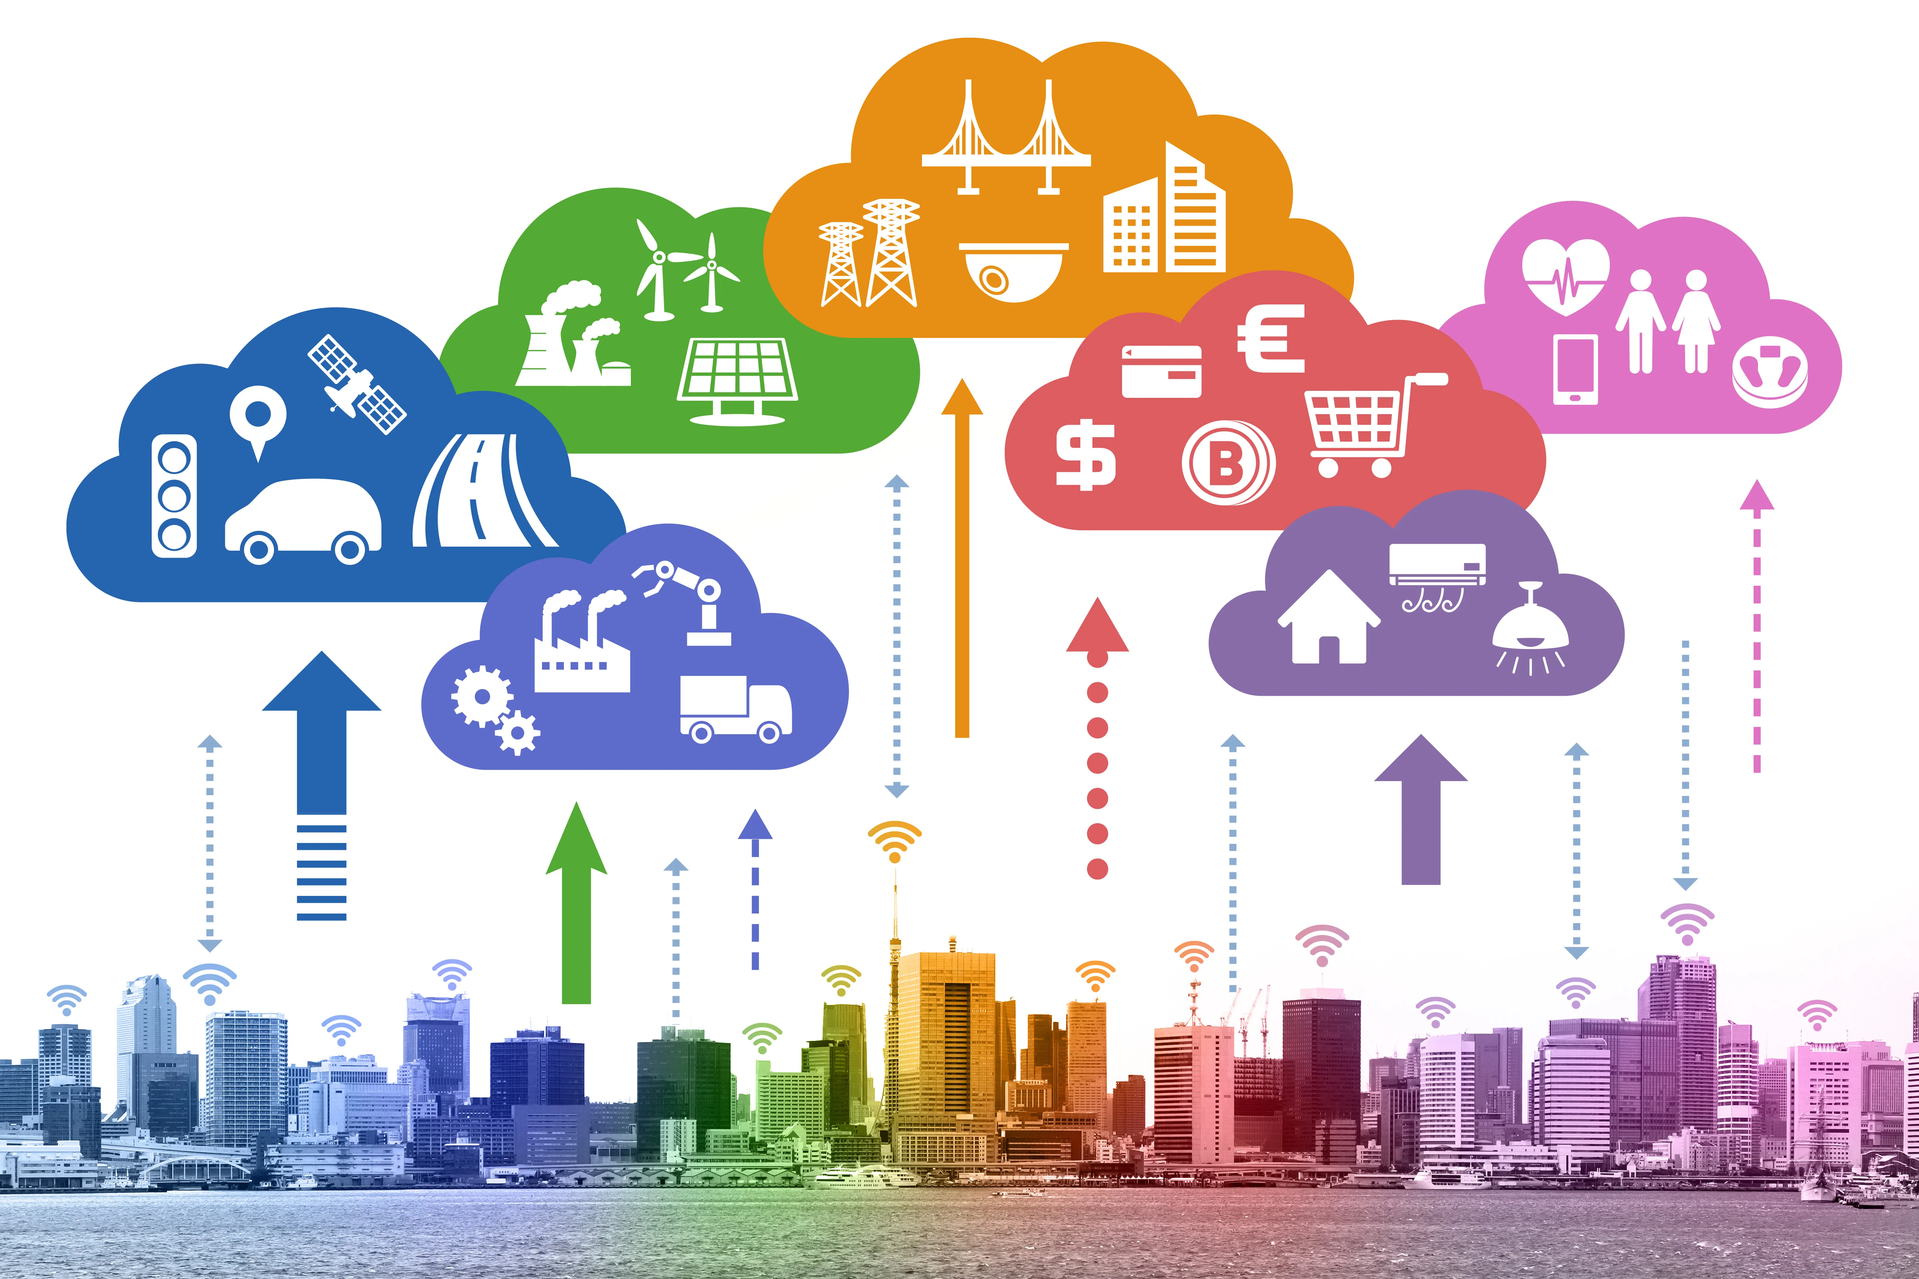
SMART ENVIRONMENTAL MONITORING SYSTEM
Real-time Air Quality, Temperature, and Humidity Tracking via LoRa Sx1278 and Cloud Integration.
Batch-PGES2023
Piyush Singh
03rd August 2023

Slide 2
Index
S.No | Content | Page no.
1 | Summary | 4
2 | Introduction | 5
3 | Literature Survey | 6
4 | Problem Definition | 8
5 | Solution Strategy | 9
6 | Block Diagram | 10-11
7 | Flowchart | 12
8 | Circuit diagram | 13-14
9 | Process Flow Diagram | 15
10 | Methodology | 16
11 | Results and discussion | 17-19
12 | Limitations | 20
13 | Future Scope | 21
14 | Conclusion | 22
15 | Business level application | 24-26

Slide 3
Environmental Monitoring System - Introduction

Slide 4
Summary
Environmental monitoring plays a crucial role in understanding the impact of air quality, temperature, and humidity on human health and the ecosystem.
The proposed system comprises sensor nodes equipped with a dedicated set of sensors designed to measure air pollutants, ambient temperature, and relative humidity.
The LoRa SX1278 module facilitates long-range and low-power communication, enabling seamless data transmission from the sensor nodes to a central gateway.
By utilizing LoRa technology, the system achieves long-range communication, reducing the need for complex infrastructure.

Slide 5
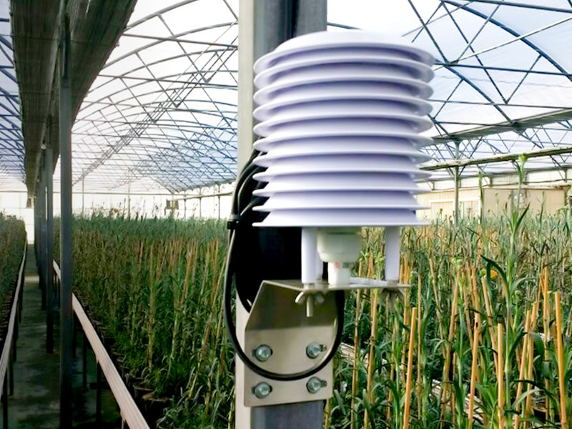
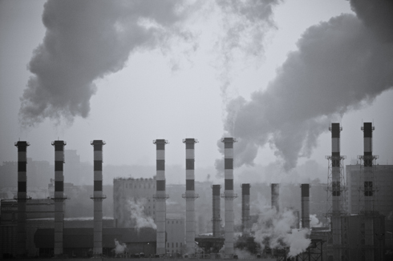
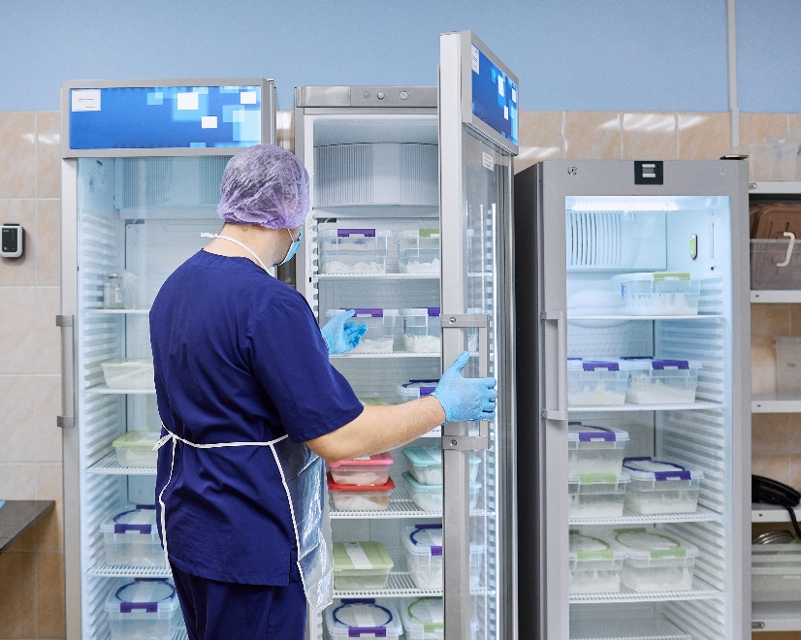
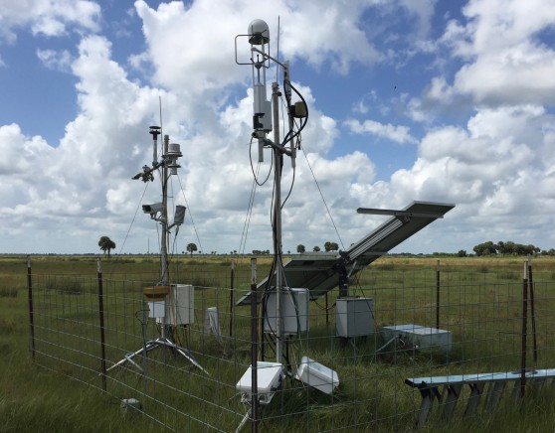
Introduction
The Air Quality and Temperature Humidity Monitoring System is a comprehensive project aimed at designing and implementing a robust solution for real-time monitoring of air quality, temperature, and humidity.
The system utilizes cutting-edge technologies, including the SX1278 LoRa module, Arduino microcontroller, DHT11 sensor, and MQ7 gas sensor, to collect, process, and transmit environmental data to a cloud-based platform.
LoRa technology is well-suited for environmental monitoring projects due to its low power consumption, extended range, and ability to penetrate obstacles, making it ideal for transmitting data.

Slide 6
Literature survey
S.No | Author(s) | Title | Findings
1. | Mia Rosmiati, Fitri Susanti, Moch. Fahru Rizal . | "IoT-Based Environmental Monitoring and Tracking System for Smart Cities Using LoRaWAN and Cloud Computing" . | The research highlights the importance of LoRaWAN technology for long-range communication and cloud integration for real-time data processing and analysis.
2. | Waheb A. Jabbar . | “LoRaWAN-Based IoT System Implementation for Long-Range Outdoor Air Quality Monitoring” | This research explores the integration of IoT and LoRa technology for real-time environmental monitoring.
3. | Mohammad Fadhli, Asriyadi Acridid, Andi Ramadhan,Gita Affrylia | "Environmental Data Acquisition and Processing in Smart Cities Using LoRaWAN“. | While the research covers multiple environmental parameters, it emphasizes the significance of air quality, temperature, and humidity monitoring in shaping smart city initiatives.
4. | D.Monica Satyavathi, B.Vandana Mala, Ch.Veera Vamsi,Ch.Neeraj . | "An Air Pollution Monitoring System Based on LoRa and MQTT.” | The research presents a case study of an air quality monitoring system deployed in an urban area. The study highlights the advantages of LoRaWAN technology in providing real-time environmental data for urban planning and pollution control.
References:
1.https://www.researchgate.net/publication/332564134_pollution_monitoring_system_using_LoRa_modul_as_transceiver_system
2.https://www.researchgate.net/publication/360385762_LoRaWAN-Based_IoT_System_Implementation_for_Long-Range_Outdoor_Air_Quality_Monitoring
3. https://www.atlantis-press.com/proceedings/first-t1-t2-21/125970302
4. https://eprajournals.com/IJSR/article/7570

Slide 7
Environmental Monitoring System – Solution

Slide 8

Problem definition
Lack of real -time monitoring capabilities and analysis.
Traditional monitoring methods is limited ,resulting in insufficient data.
The existing system often require high expenditures, and consumes excessive power.

Slide 9
Solution strategy
LoRa SX1278 Communication Technology
Centralized Cloud Integration
Sensor Network Deployment
Selection of sensors to measure temperature, humidity and air quality.
Utilized LoRa Sx1278 to enable data transmission over vast geographical areas , which minimized the need for complex infrastructure .
Establish a cloud-based platform to centralize and store the data collected from the sensor nodes.

Slide 10
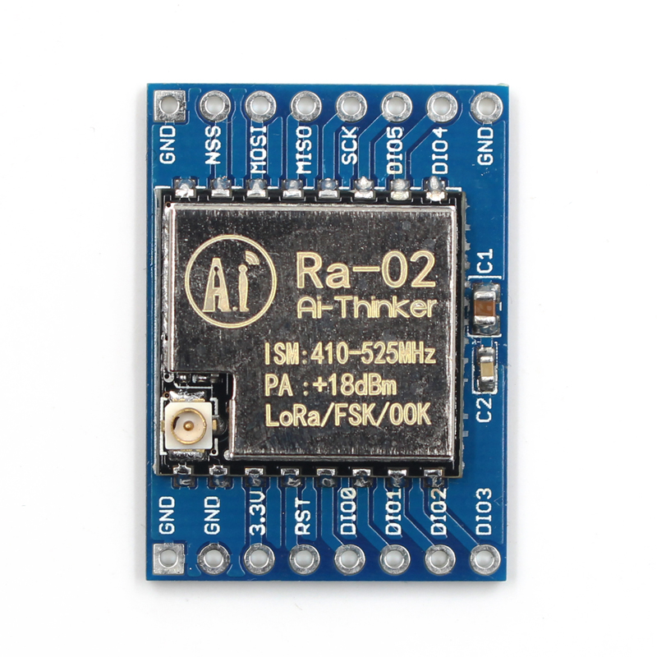
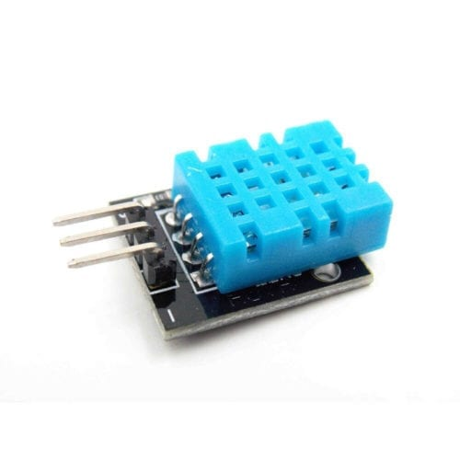


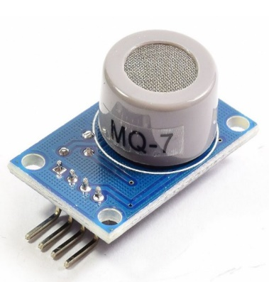
Block diagram(1/2)
BLOCK DIAGRAM OF TRANSMITTER SIDE
DHT11
Cloud
Arduino Uno
LoRa sx1278
MQ-7
The transmitter side, also known as the sensor node, is responsible for collecting environmental data such as air quality, temperature, and humidity using DHT11 and MQ-7 sensors.

Slide 11
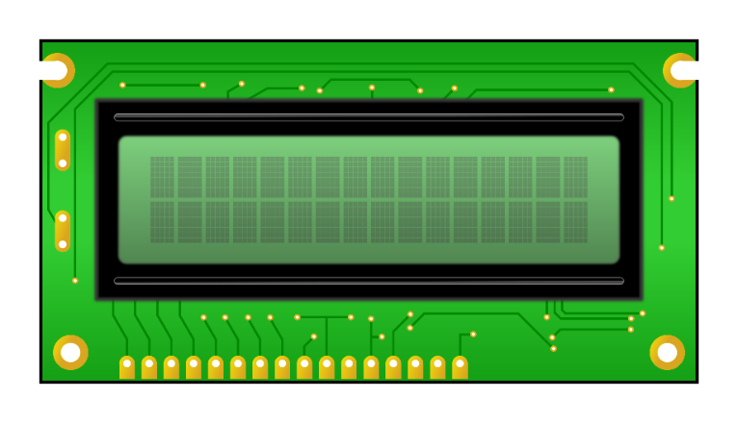
Block diagram(2/2)
BLOCK DIAGRAM OF RECEIVER SIDE
Cloud
Display
Arduino uno
LoRa sx1278
The receiver side, also known as the cloud-based platform, is responsible for receiving, processing, storing, and analyzing the data transmitted from the sensor node (transmitter side).

Slide 12
Flowchart
START
Initialize the system components (Arduino, DHT11, MQ7, SX1278 LoRa module
Configure LoRa network settings
Read sensor data (temperature, humidity, CO concentration) from DHT11 and MQ7 sensors
Process the raw sensor data
the processed data for transmission
NO
Check LoRa network availability Package
Yes
Transmit data to the cloud platform via the SX1278 LoRa module
STOP
Receive data packets from the LoRa network and Store the received data securely in cloud
Display the store data

Slide 13
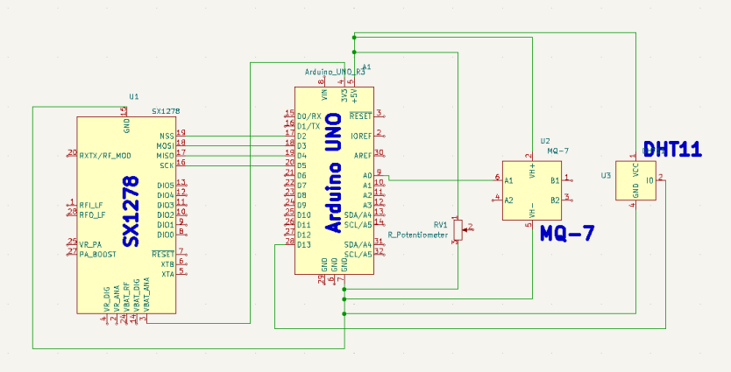
Circuit diagram(1/2)
Circuit Diagram of Transmitter End.

Slide 14
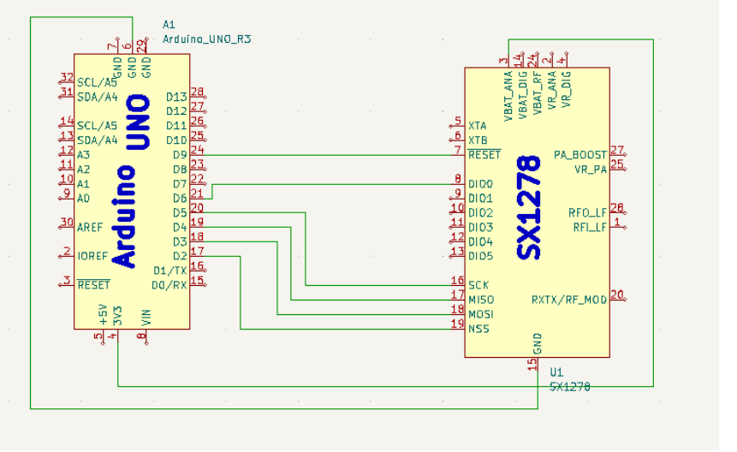
Circuit diagram(2/2)
Circuit Diagram of Receiver Side.

Slide 15
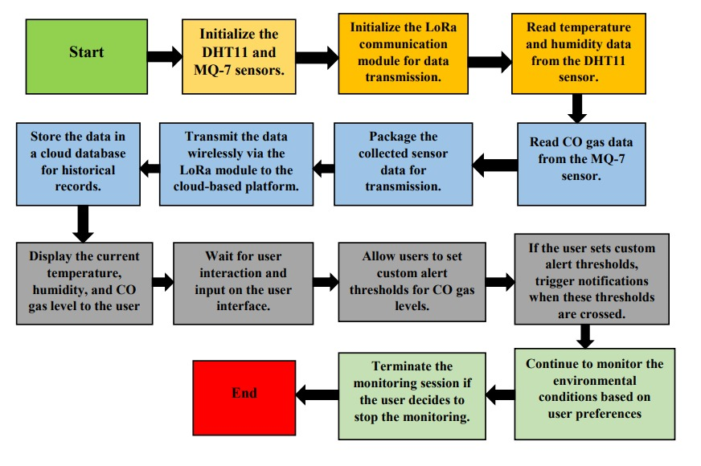
Process flow diagram

Slide 16
Methodology
Step 1: Hardware Setup:Connect the SX1278 LoRa module to the Arduino board using SPI communication.
Step 2:Write Arduino code to read data from the DHT11 and MQ7 sensors periodically
Step 3:Implement LoRa communication code on the Arduino to transmit the sensor data using the SX1278 module.
Step 4:Create an account on the Tago platform (https://tago.io/) and Set up a new device in the Tago platform to receive data from the Arduino.
Step 5:Modify the Arduino code to include Tago's communication protocol HTTP.

Slide 17
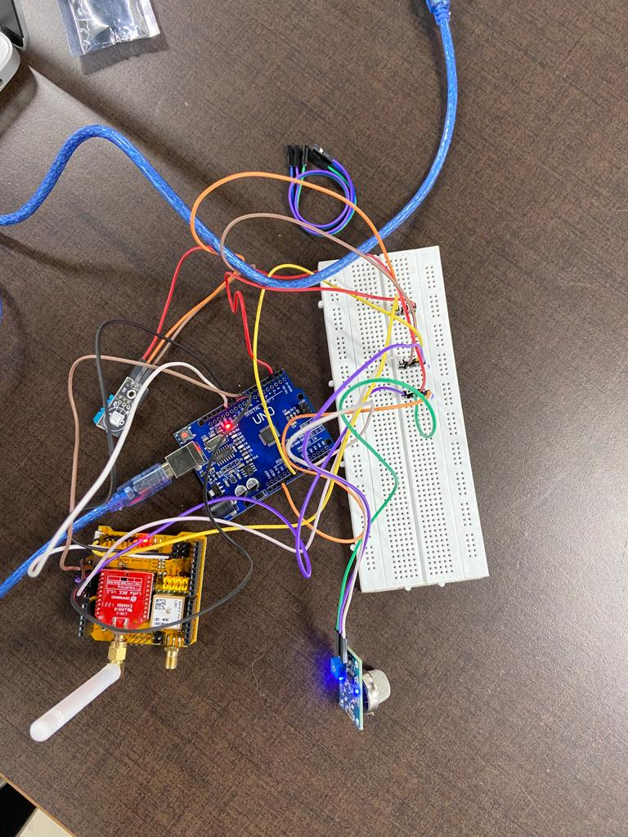
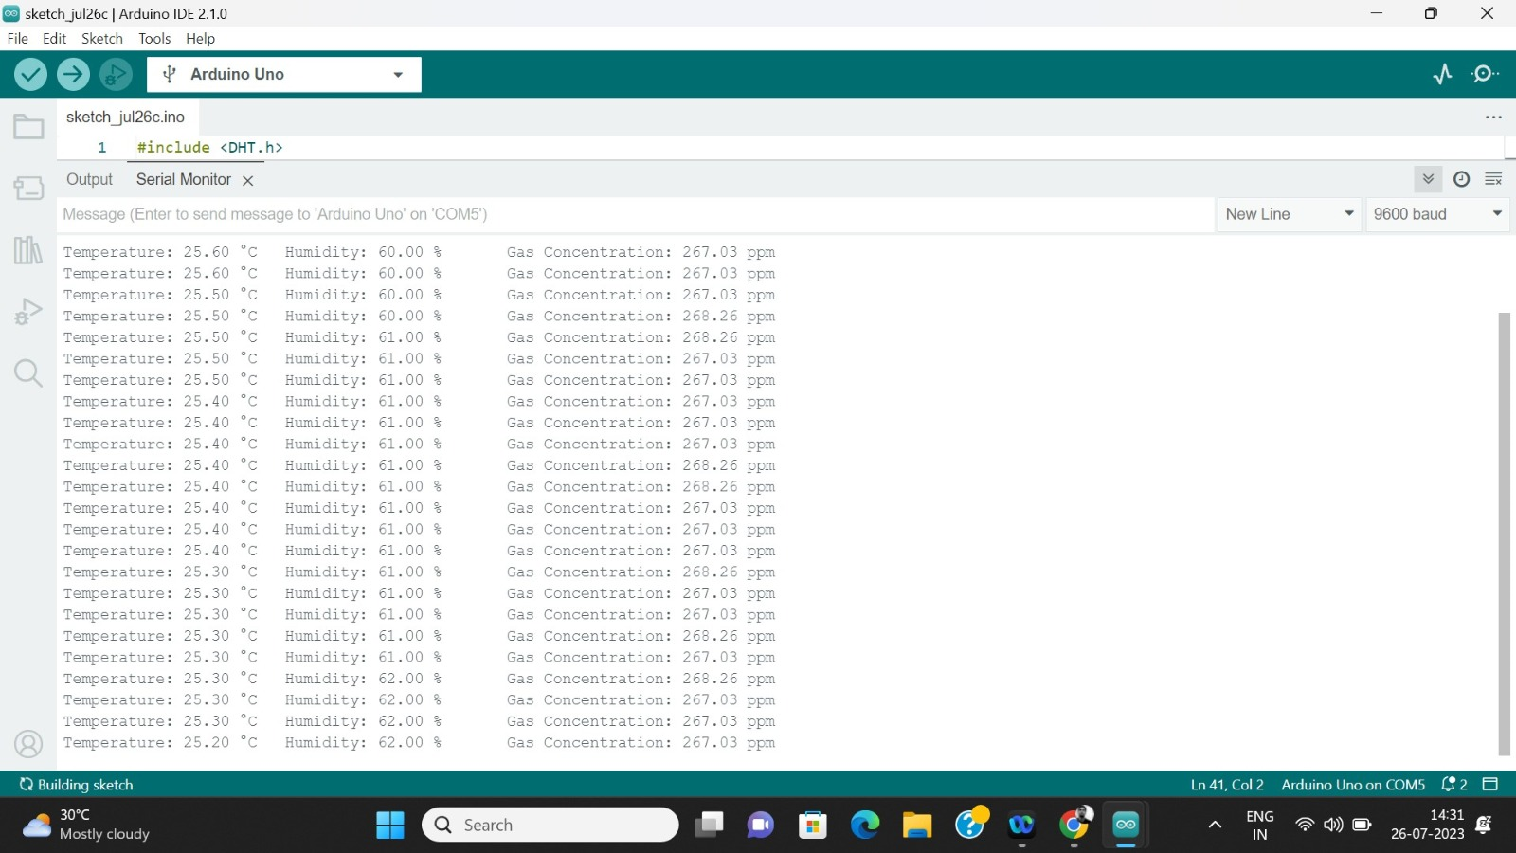
Results and discussion(1/3)
Transmitter side

Slide 18
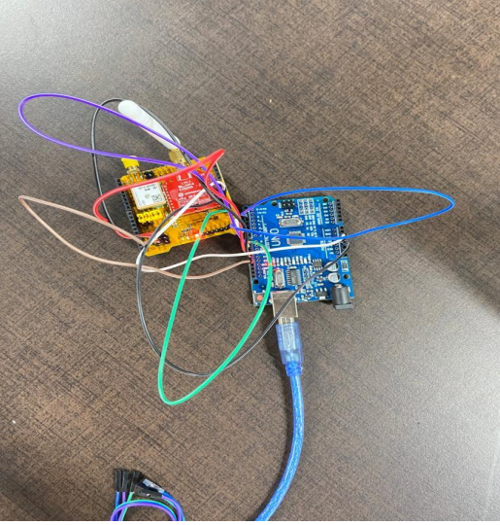

Results and discussion(2/3)
Receiver Side Connection

Slide 19
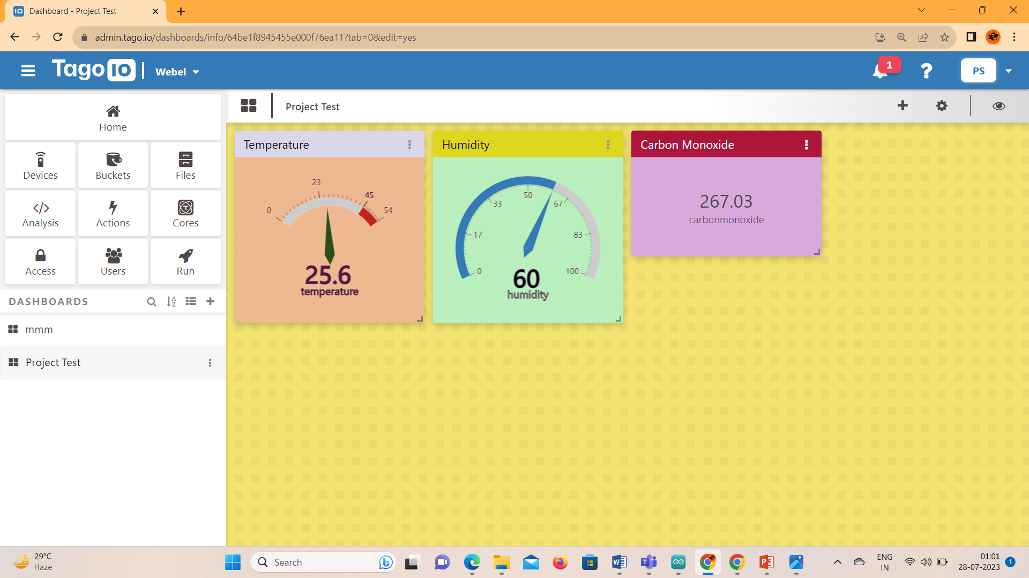
Results and discussion(3/3)
Dashboard of Cloud

Slide 20
Limitations
1.Limited Sensor Accuracy
3.Initial Setup Cost
2.Latency
4.Reliability on Internet Connectivity
1. The accuracy of the sensor data may vary based on the quality and calibration of the sensors used.
2. Data transmission over the LoRaWAN network can experience latency, causing a delay in receiving real-time data.
3. The deployment of sensor nodes, LoRaWAN gateways, and cloud infrastructure may involve initial setup costs
4. The system heavily relies on internet connectivity for transmitting data to the cloud server and accessing real-time information.

Slide 21
Future scope of the proposed model
Additionally, there will be integration of a localized server exclusively designed for storing historical data, which will be interconnected with the system.
Currently, while the data is displayed on a cloud-based UI, the system itself can establish a smooth and uninterrupted connection between the transmitter and receiver even across considerable distances.
The data can be presented on a dedicated display rather than a laptop, eliminating the need for continuous cloud verification and streamlining the process.

Slide 22
Conclusion
The project demonstrated a practical and functional solution for real-world air quality and environmental monitoring.
Data collected from the sensor node was transmitted in Realtime to the cloud server which allowed continuous monitoring and analysis of air quality, temperature, and humidity from remote locations.
Overall, the implementation of air quality monitoring, temperature, and humidity tracking via LoRaWAN with cloud integration offers a scalable, cost-effective, and data-driven approach to environmental monitoring.
It serves as a foundation for potential applications in smart cities, agriculture, and industrial settings.

Slide 23
Environmental Monitoring System – Market

Slide 24
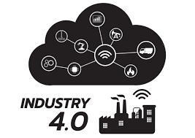

Industrial business level application of the project(1/2)
Smart Cities
Industries
Why ?
Environmental awareness.
Public Health improvement .
Disaster alertness and response.
How?
Select Sensors Technology .
Sensor deployment .
Data Connection and communication.
Real Time monitoring and visualization.
Result
Improve public Health.
Sustainable and urban development.
Early warning and disaster alertness .
Why?
Emission Monitoring .
Air quality and Indoor Environment.
Remote monitoring and maintenance.
How?
Select Sensors Technology.
Data Connection and communication .
Real Time monitoring and visualization.
Result
Emissions reduction .
Risk mitigation.
Data driven decision making .

Slide 25


Industrial business level application of the project(2/2)
Agriculture
Health
Why?
Crop Health monitoring.
Crop selection and rotation.
Microclimate Management.
How?
Select Sensors Technology .
Data Connection and communication.
Real Time monitoring and visualization.
Result
Long-Term Sustainability.
Reduced environment impact.
Data-Driven Decision Making.
Why?
Infection control.
Temperature and Humidity Control.
Chronic Disease Management.
How?
Select Sensors Technology.
Data Connection and communication.
Real Time monitoring and visualization.
Result
Improve patients safety.
Early disease outbreak detection.
Community health awareness .

Slide 26
Worldwide market size
CAGR 5.40%
Expected to grow at a CAGR of 5.40% during the forecast period (2023-2032)

Slide 27
References
[1] J. Jo, B. Jo, J. Kim, S. Kim, W. Han Development of an iot-based indoor air quality monitoring platform Journal of Sensors, 2020 (2020) .
[2] G. Zhao, G. Huang, H. He, Q. Wang Innovative Spatial-Temporal Network Modeling and Analysis Method of Air Quality IEEE (2019).
[3] H. Gupta, D. Bhardwaj, H. Agrawal, V. A. 2019 IEEE International Conference on Sustainable Energy Technologies (ICSET).
[4] S. Devarakonda, P. Sevusu, H. Liu, R. Liu, L. Iftode, B. Nath Real-time air quality monitoring through mobile sensing in metropolitan areas Proceedings of the 2nd ACM SIGKDD international workshop on urban computing, ACM (2013).
[5] R. Kiruthika, A. Umamakeswari Low cost pollution control and air quality monitoring system using Raspberry Pi for Internet of Things 2017 International Conference on Energy, Communication, Data Analytics and Soft Computing (ICECDS), IEEE (2017).

Slide 28

Batch-PGES2023
Piyush Singh

